Slide 1
2017 KDD Luck is Hard to Beat: The Difficulty of Sports Prediction
数据挖掘课程论文阅读
第X小组
Notes:
加上组员信息

Slide 2
Sports are extremely surprising
Unpredictability cannot be avoided
Skill
Luck

Slide 3
Goals & Methods
Evaluate the luck and skill influence in sports leagues
Skill influence -> Ф coefficicent
Significant test
Which teams should be removed to make a league random
Estimate the teams' skill
Teams' skill in a season/league
What explains skill?

Slide 4
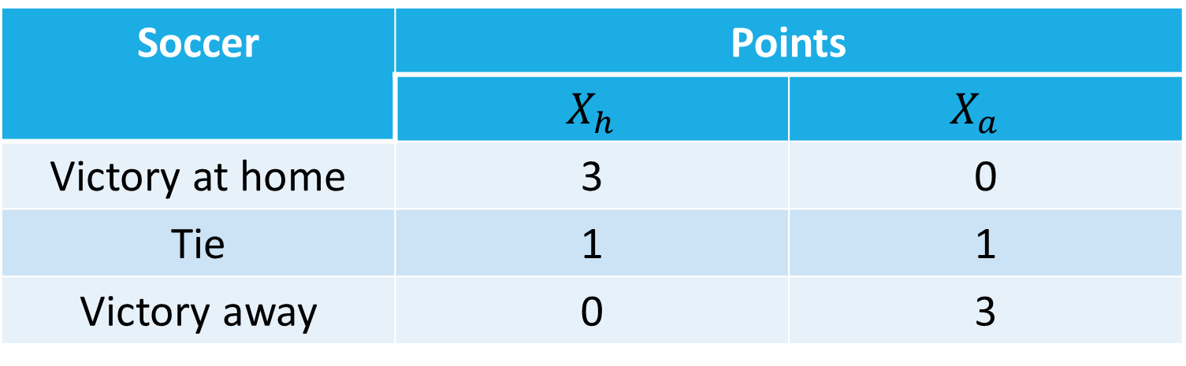
A luck and skill coefficient
For soccer:
Soccer | Points
 | $X_{h}$ | $$X_{a}$$
Victory at home | 3 | 0
Tie | 1 | 1
Victory away | 0 | 3

Slide 5
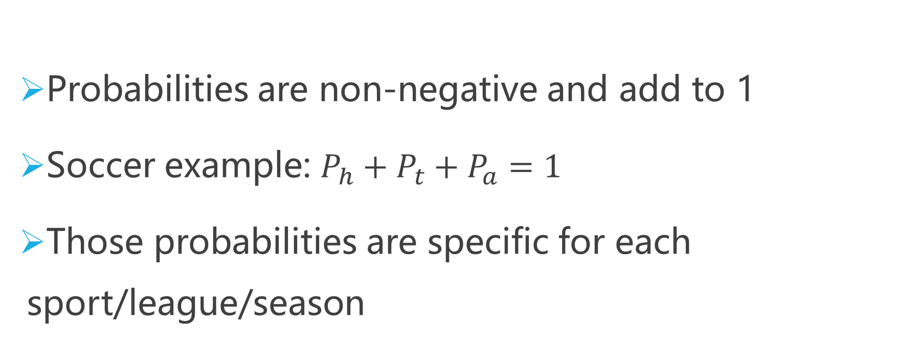
A luck and skill coefficient
Probabilities are non-negative and add to 1
Soccer example: $P_{h}+P_{t}+P_{a}=1$
Those probabilities are specific for each sport/league/season
Notes:
概率->期望->

Slide 6
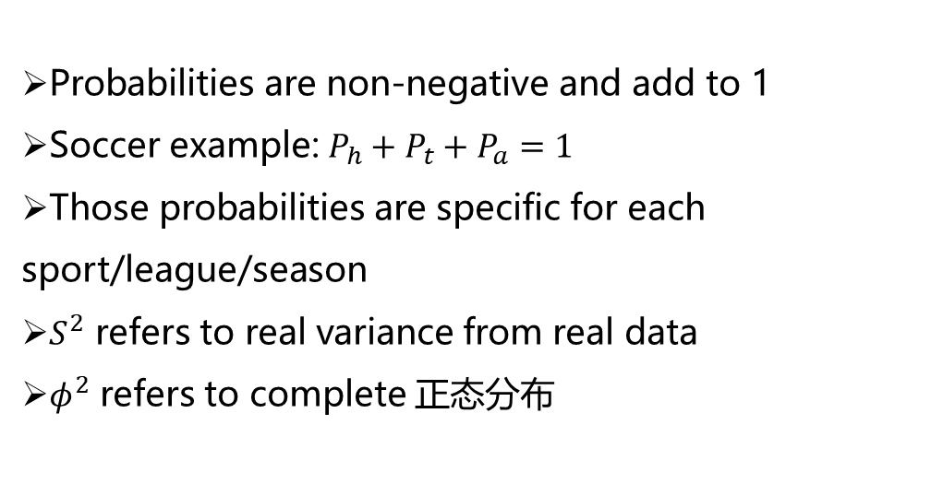
A luck and skill coefficient
Probabilities are non-negative and add to 1
Soccer example: $P_{h}+P_{t}+P_{a}=1$
Those probabilities are specific for each sport/league/season
$S^{2}$ refers to real variance from real data
$φ^{2}$ refers to complete 正态分布

Slide 7
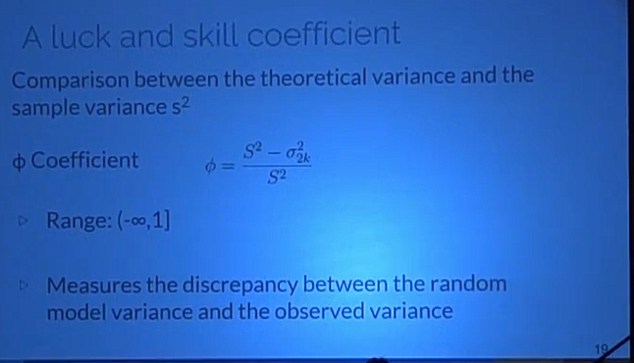
A luck and skill coefficient

Slide 8
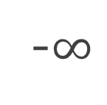
A luck and skill coefficient
-$∞$
0
1
Atypical
Luck
Skill
Close to 1: skill factor has more influence

Slide 9
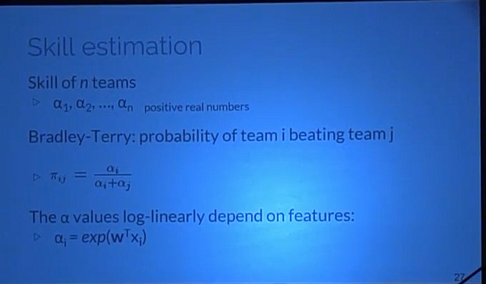
Skill estimation
Notes:
Skill estimation
Probabilities Graphical Model
Seasons/Leagues with significantly different of 0 and positive
Skill component is decomposed into explanatory features
Only basketball, NBA

Slide 10
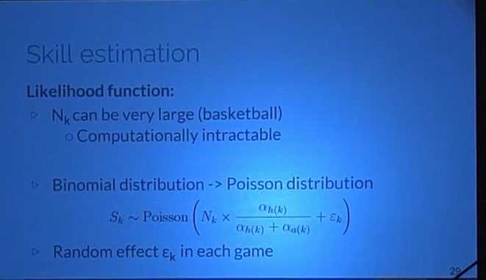
Skill estimation
Likelihood function:
Notes:
Likelihood function:
Games final score
K games and $n$ teams
$N_{k }$: total points of each team
$S_{k}$: points of the home team
$N_{k }$is a sequence of success and failures
$S_{k }$~ Binomial Distribution conditioned in $N_{k }$

Slide 11
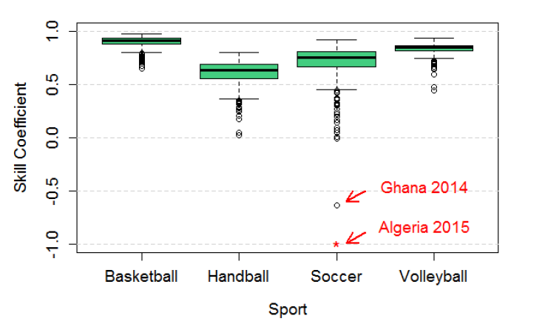
Some results with Ф Coefficient
Notes:
越接近上限1，越接近随机模型，更重要的是解释最终得分的技能组件。 篮球是最后一项成绩最大的运动。 第二个是排球，第三个是足球，第四个是手球。

Slide 12
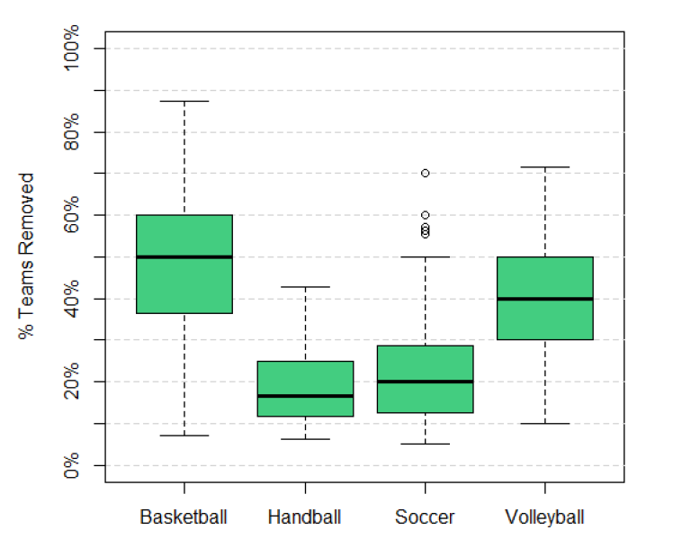
How many teams should be removed to make it random?

Slide 13
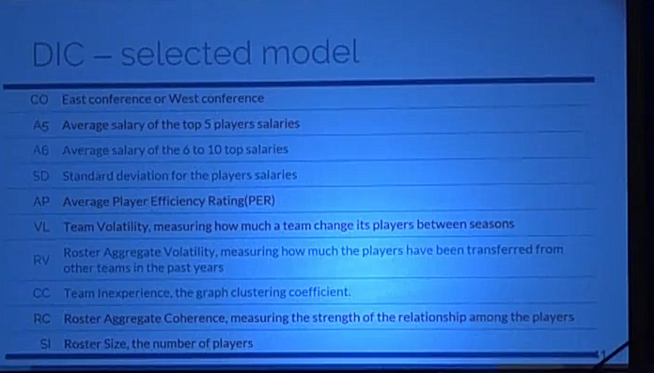
DCI-selected model

Slide 14
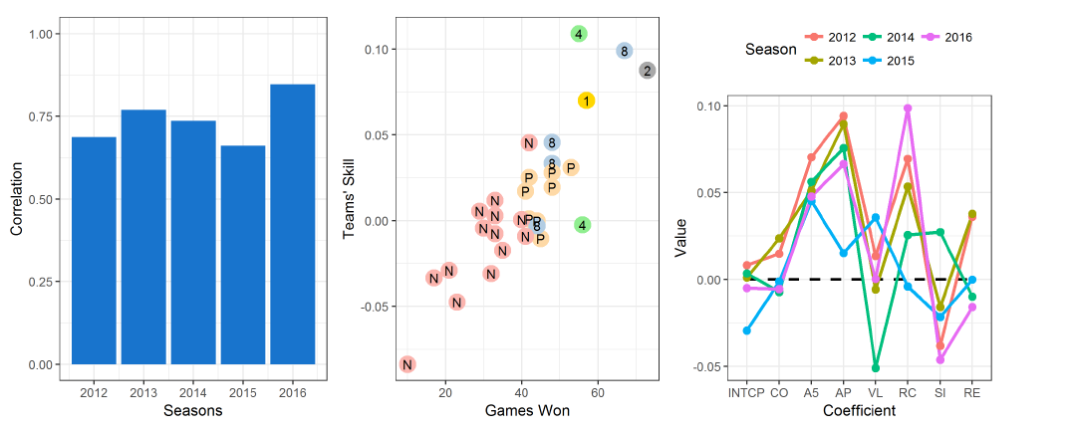

Slide 15
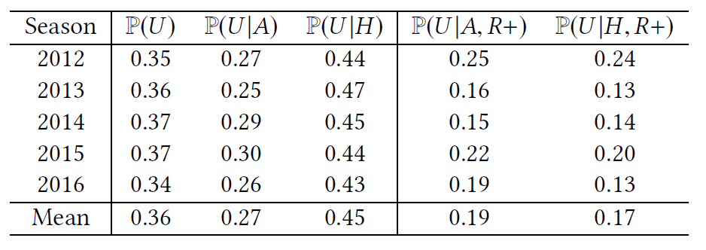
When the underdog plays at home, its winning probability increase 0.18
This effect disappears if playing against the best ones

Slide 16
Management strategy
Building smaller teams allow for higher salaries
It also increase the odds of attracting high PER players and increasing rapport(roster aggregate coherence)
Smaller, more cohesive teams have less conflicts and are easier to manage

Slide 17
Conclusion
Contribution
Ф coefficient
Which leagues and sports are more competitive
Bayesian model
Which features have more influence on the skill

Slide 18
Attractive area
Relatively isolated system seen repeatedly
Many datasets available
Popularity
Economic Relevance
Notes:
84个国家的1503个赛季的198个联赛4种不同的运动：篮球，足球，排球和手球

Slide 19
Related Work

Slide 20
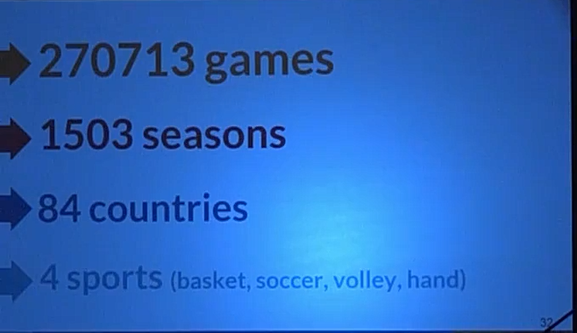

Slide 21
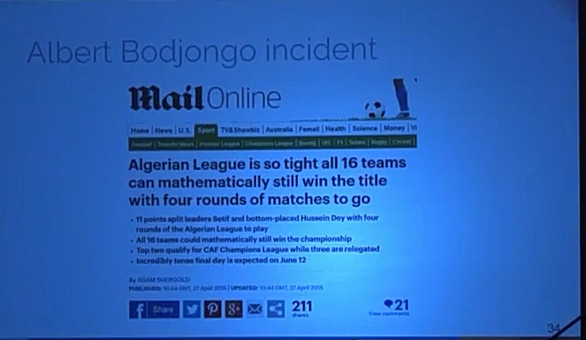
Albert Bodjongo incident

Slide 22
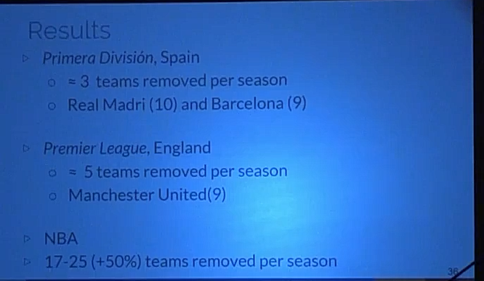
Results

Slide 23
Skill estimation
Probabilities Graphical Model
Seasons/Leagues with significantly different of 0 and positive
Skill component is decomposed into explanatory features
Only basketball, NBA

Slide 24
Dados
League
National Basketball Association(NBA)
Regular Season: round-robin system(=1230 matches)
Playoffs: 16 teams

Slide 25
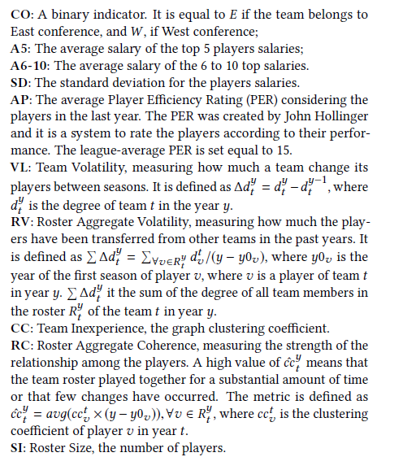
Features

Slide 26


Skill estimation
Likelihood function:
Games final score
K games and $n$ teams
$N_{k }$: total points of each team
$S_{k}$: points of the home team
$N_{k }$is a sequence of success and failures
$S_{k }$~ Binomial Distribution conditioned in $N_{k }$

Slide 27
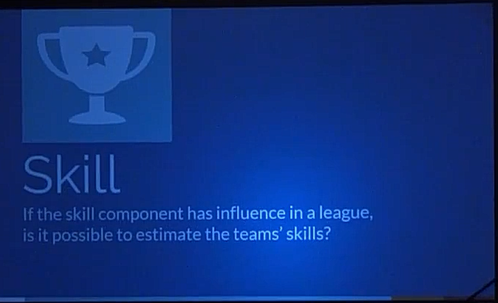

Slide 28
Results
Ф Coefficient

Slide 29
A luck and skill coefficient
-$∞$
0
1
Atypical
Luck
Skill
Close to 0: skill factor has a small influence in the results

Slide 30
A luck and skill coefficient
-$∞$
0
1
Atypical
Luck
Skill
Negative values: observed variance is LESS than the expected value under the random model

Slide 31

A luck and skill coefficient
Confidence interval(95%) around 0
-$∞$
0
1
Atypical
Luck
Skill
Monte Carlo simulation considering true the random model hypothesis

Slide 32
A luck and skill coefficient
If Ф is significantly different from 0,
how many teams should be removed from a league in order to turn it random?
By repeated simulation

Slide 33
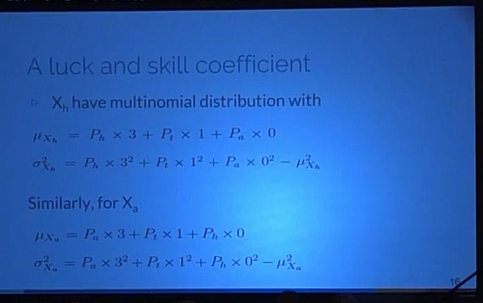
A luck and skill coefficient

Slide 34
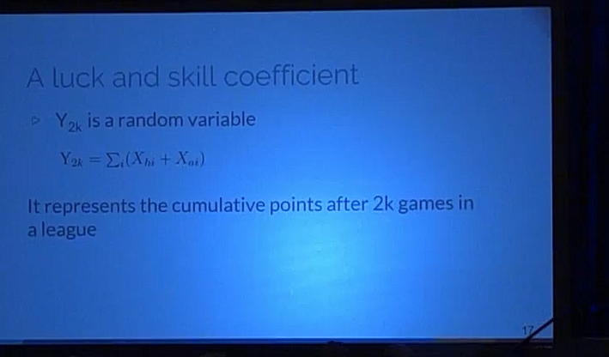
A luck and skill coefficient

Slide 35
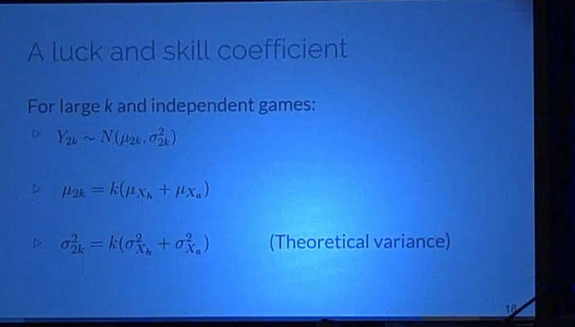
A luck and skill coefficient

Slide 36
Disentangling luck and skill

Slide 37
A luck and skill coefficient
Leagues considered
Teams with the same number of games
Each team plays twice against all others, once at home
The final result is total number of points accumulated
Contextual factors allowed(home advantage only)

Slide 38
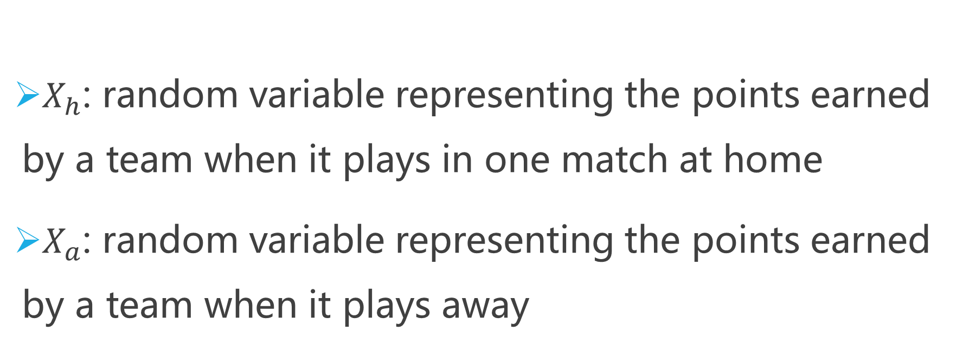
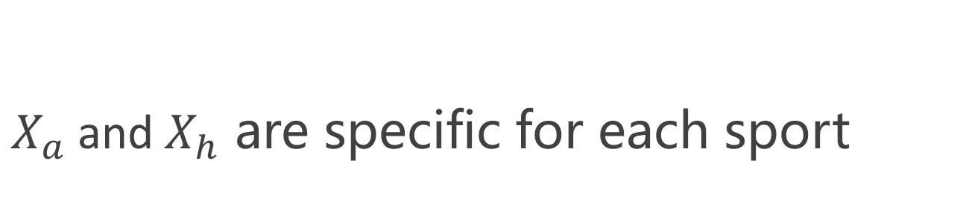
A luck and skill coefficient
$X_{h}$: random variable representing the points earned by a team when it plays in one match at home
$X_{a}$: random variable representing the points earned by a team when it plays away
$X_{a}$and$X_{h}$ are specific for each sport

